Slide 1
Welcome to our Presentation

Slide 2
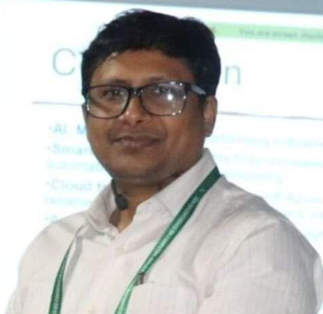
Our team Name: Squad
Submitted to
Dr. MD. Abu Layek
Professor
Department of Computer Science & Engineering
Jagannath University

Slide 3
Presentation Title:
“Cloud‑based virtualization environment for IoT‑based WSN: solutions, approaches and challenges.”

Slide 4
Contents of this Article
Acquaintance
Objectives
Sensor Cloud Paradigm
Methodology
Cloud‑based virtualization solution
Applications
Challenges of cloud Computing
Summary
Future and Conclusion.

Slide 5

Jerin Tesnim ID: M240205005
Department of Computer Science & Engineering
Jagannath University

Slide 6

Acquaintance
IOT has revolutionized….
Traditional Wireless Sensor Networks (WSN) lack the processing power, storage, and resource-sharing capabilities required by modern IoT applications….
BRAND NAME

Slide 7
Objectives
1. Energy consumption issues.
2. Insufficient storage and processor power.
3. Inefficient data management.
4. Application-specific constraints requiring network reconfiguration.
5. Complexity of Re-deployment.

Slide 8
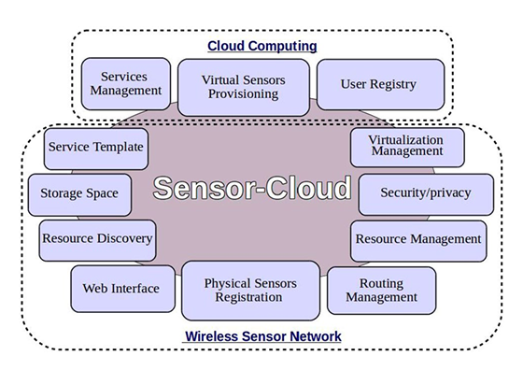
Sensor Cloud Paradigm
1. Virtualization Management
2. Resource Management
3. Service Templates

Slide 9

Israt Jahan Swarna ID: M240205035
Department of Computer Science & Engineering
Jagannath University

Slide 10
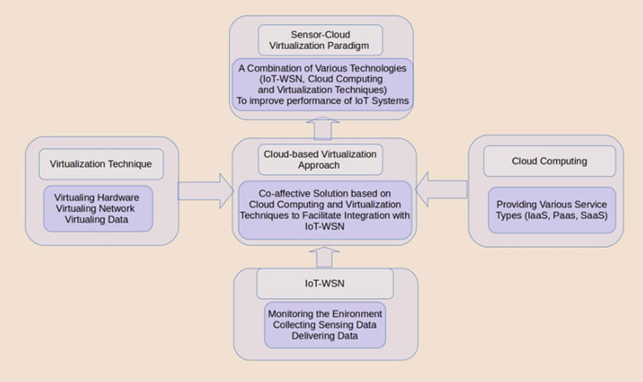
Methodology

Slide 11
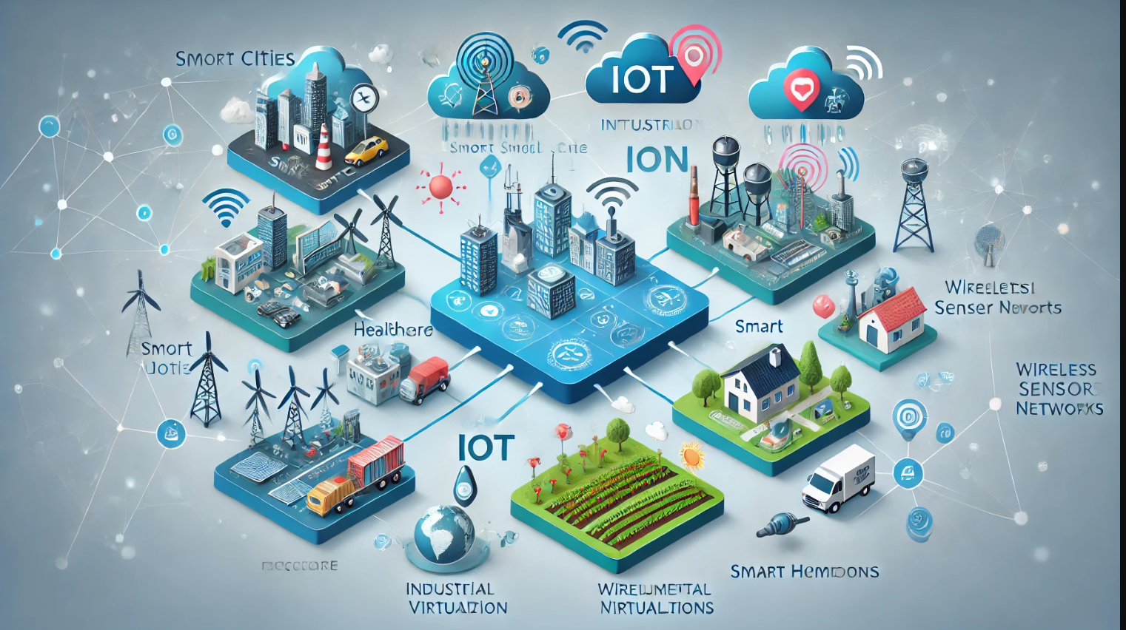

Cloud‑based virtualization solution:
1. Virtualized Hardware
2. Support for Applications
3. Scalable Environments
4. Enhanced IoT-WSN
5. Sensor-Cloud Paradigm

Slide 12
Applications
Environmental Monitoring
Industrial Automation
Smart Cities
Smart Homes and Buildings
Healthcare Monitoring
Agriculture
1
4
2
5
3
6

Slide 13

Homayra ID: M240205013
Department of Computer Science & Engineering
Jagannath University

Slide 14
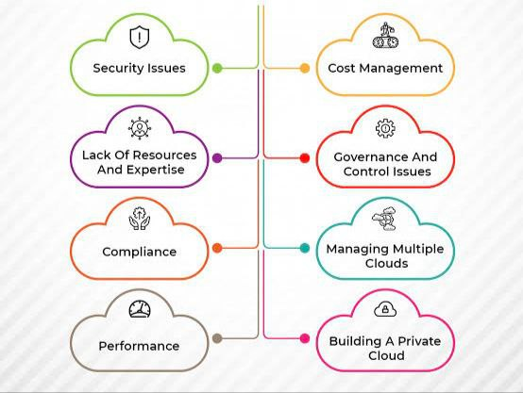
Challenges of cloud computing
Sensor-Cloud Virtualization approach is a recent trend in which the already existing infrastructure can be utilized to serve many more users. This has attracted major attention in recent years, attracting researchers and software designers. However, in this section, we summarize some of the tremendous challenges in this orientation study.
Architecture Layers
Physical sensors management
Dynamic networks formation

Slide 15
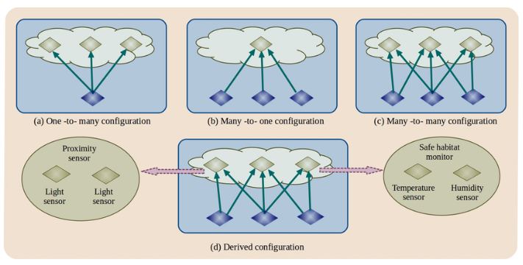
SUMMARY
We present the integration process of sensor networks with Cloud-based Virtualization and propose a new general architecture view for the Sensor-Cloud paradigm, and discuss its key elements, basic principles, lifecycle operation, and outline its advantages and disadvantages. Finally, we review the state-of-the-art, present the major challenges, and suggest future work directions.

Slide 16
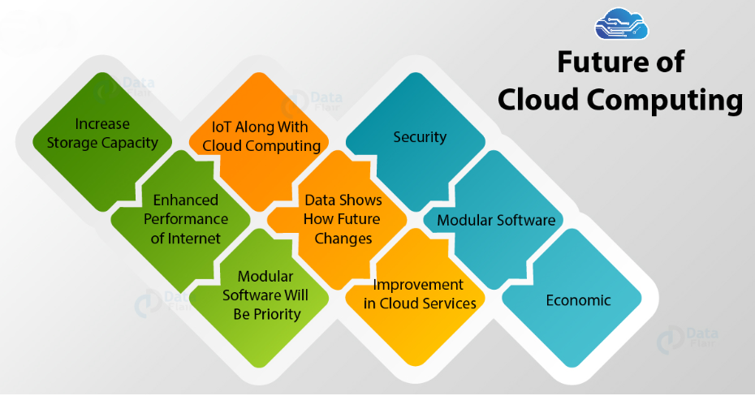
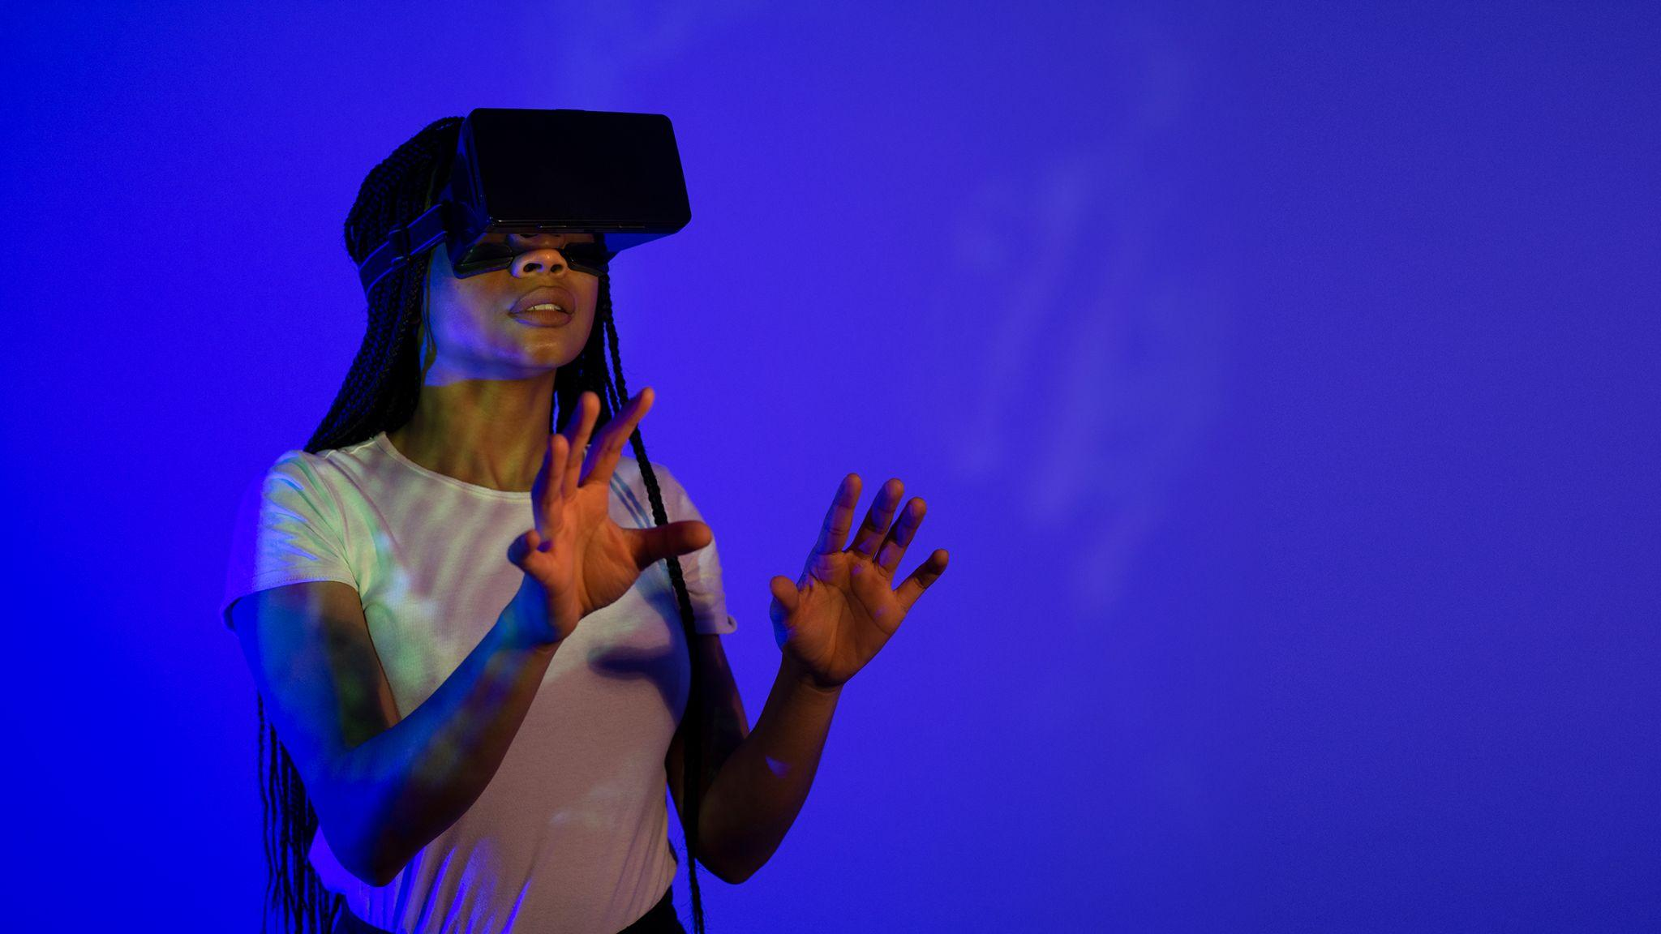
Integrating IoT-WSN with a Cloud-based Virtualization approach is an innovative solution for many issues facing IoT sensing systems, such as data sharing, data processing, scalability, storage, etc. Our future work is to study the impact of Fog computing in reducing processing time and enhancing the performance of the Sensor-Cloud paradigm.

Slide 17
Questions
1. What is the primary goal of integrating Cloud-based Virtualization with IoT-based WSN? - 2
2. How does Cloud Computing address the limitations of traditional WSN? -
3. What are the key elements of the Sensor-Cloud approach? - 2
4. What challenges are associated with the Sensor-Cloud paradigm? - 2
5. What future research directions does the paper suggest? - 2
6. How can stakeholders maximize profits while using sensor networks? - 2
7. What is the significance of virtualization techniques in WSN? - 2
8. What are the advantages of the Sensor-Cloud architecture? - 2
9. What role does Big Data play in the Sensor-Cloud paradigm? - 2
10. Why is security a critical concern in the Sensor-Cloud approach? - 2

Slide 18
Any questions?...

Slide 19

PDF of Paper:
https://doi.org/10.1007/s12652-021-03515-z
Authors: Nasr Almurisi & Srinivasulu Tadisetty
Journal: Journal of Ambient Intelligence and Humanized Computing

Slide 20
Thank You..

